Slide 1
Vectors

Slide 2
Vectors and Scalars
Scalar Quantity – a quantity that can be completely described by giving its magnitude only.
Example: speed, time, energy, temperature
Vector Quantity – a quantity that can be completely described by giving its magnitude and direction.
Example: velocity, force, acceleration, momentum

Slide 3
Vector Viewed Geometrically
A vector v is represented geometrically by arrow in 2-space or 3-space.
The direction of the arrow specifies the direction of the vector, and the length of the arrow describes the magnitude.
The tail of the arrow is called the initial point of the vector, and the tip of the arrow the terminal point.

Slide 4
Vector Viewed Geometrically
y z
y
x
x

Slide 5
Notations
For vectors,
Vectors are denoted by lowercase boldface type such as a, k, v, w, and x.
For scalars,
Scalars are denoted by lowercase italic type such as a, k, v, w, and x.

Slide 6
Equal (equivalent) vectors
Two vectors, v and w, are equal (also called equivalent) if they have the same length and same direction, in which case we write v = w.
Geometrically, two vectors are equal if they are translations of one another or they are in different positions.

Slide 7
Zero Vector
If the initial and terminal points of a vector coincide, then the vector has length zero; we call this the zero vector and denote it by 0.
The zero vector does not have a specific direction.

Slide 8
Vector v = AB
If the initial point of v is A and the terminal point is B, then we write v = AB.
y v
Vector with Initial Point at the Origin
A vector v is positioned with its initial point at the origin and terminal point (v₁ , v₂ ) or (v₁ , v₂ , v₃ ). The coordinates of the terminal point of v are called the components of v. Thus,
v = <v₁ , v₂ > or v = <v₁ , v₂ , v₃ >
B
A
x

Slide 9
Note: We write v in component form using the bracket notation
v = <v₁ , v₂ > or v = <v₁ , v₂ , v₃ >
2-space 3-space

Slide 10
Vector with Initial Point not at the Origin
Theorem: If P₁ P₂ is a vector in 2-space with initial point P₁ (x₁ , y₁) and terminal point
P₂ (x₂ , y₂ ), then
P₁ P₂ = <x₂ – x₁ , y₂ – y₁>
Similarly, if P₁ P₂ is a vector in 3-space with initial point P₁ (x₁ , y₁, z₁ ) and terminal point P₂ (x₂ , y₂ , z₂ ), then
P₁ P₂ = < x₂– x₁ , y₂ – y₁ , z₂ - z₁>

Slide 11
Arithmetic Operations on Vectors
If v = <v₁ , v₂> and w = <w₁ , w₂> are vectors in 2-space and k is any scalar, then
a) v + w = <v₁ + w₁ , v₂ + w₂ >
b) v – w = <v₁ – w₁ , v₂ – w₂ >
c) kv = <kv₁ , kv₂>

Slide 12
Arithmetic Operations on Vectors
Similarly, if v = <v₁ , v₂ , v₃ > and
w = <w₁ , w₂ , w₃ > are vectors in 3-space and k is any scalar, then
a) v + w = <v₁ + w₁ , v₂ + w₂ , v₃ + w₃ >
b) v – w = <v₁ – w₁, v₂ – w₂, v₃ – w₃>
c) kv = <kv₁ , kv₂, kv₃>

Slide 13
Rules of Vector Arithmetic
For any vectors u, v, and w and any scalar k and l, the following relationship hold:
u + v = v + u e) k(lu) = (kl)u
(u + v) + w = u + (v + w) f) k(u + v) = ku + kv
u + 0 = 0 + u = u g) (k + l) u = ku + lu
u + (-u) = 0 h) 1u = u

Slide 14
Visualizing vector addition, u +v
u + v acts as the diagonal of the paralellogram generated by u and v.
R
u + v v u + v
Q u
P

Slide 15
Visualizing u - v
Since u – v = u + (-v), we can draw the vector u – v by drawing –v and adding it to the vector u. v
u
-v u – v v u – v
u

Slide 16
Scalar Multiplication, kv
For v ≠ 0, the vector kv is the unique vector of length |k| ||v||, which has the direction of v if
k > 0 and the opposite direction if k < 0.
Examples:
-2a -a a 2a
-1/2 a

Slide 17
Norm of a Vector
The distance between the initial and terminal points of a vector v, is called the length, the norm, or the magnitude of v and is denoted by ǁvǁ.
For 2-space, ǁvǁ =
For 3-space, ǁvǁ =
Note: the initial point of the vector is at the origin.

Slide 18
Unit Vector
A vector of length 1 is called a unit vector.
In an xy-coordinate system, the unit vectors along the x- and y- axes are denoted by i and j, respectively. The vectors i and j in 2 space:
i = <1, 0>, j = <0, 1>
Every plane vector v = <v₁ , v₂ > can be written as a linear combination of i and j, that is,
v = <v₁ , v₂ > = v₁ i+ v₂ j

Slide 19
Unit Vector
In an xyz-coordinate system, the unit vectors along the x-, y-, and z-axes are denoted by i, j, and k, respectively. The vectors i, j, and k in 3-space:
i = <1, 0, 0>, j = <0, 1, 0>, k = <0, 0, 1>
Every vector in 3-space can be expressed as a linear combination of i, j, and k, that is,
v = <v₁ , v₂ , v₃ > = v₁ i + v₂ j + v₃ k

Slide 20
Normalizing a Vector
- the process of multiplying a vector by the reciprocal of its length to obtain a unit vector with the same direction.
u = (1/ǁvǁ) v = v/ǁvǁ

Slide 21
Vector Determined by Length and Angle
v = ǁvǁ <cos θ , sin θ> = ǁvǁ cos θ i + ǁvǁ sin θ j
where v is a nonzero vector with its initial point at the origin and θ is the angle from the positive x-axis.
For a unit vector u,
u =< cos θ , sin θ > = cos θ i + sin θ j

Slide 22
Vector Determined by its Length and a Unit Vector in the Same Direction
v = ǁvǁ u

Slide 23
Exercise Set 11.2
Sketch the vectors with their initial points at the origin.
1. b) <-5, 4> e) 3i – 2j 3. b) <2, 2, -1> d) 2i + 3j – 2k
6. Find the components of the vector AB and sketch an equivalent vector with its initial point at the origin.
a) A (2, 3), B (-3, 3) b) A (3, 0, 4), B (0, 4, 4)
10. a) Find the terminal point of v = <7, 6> if the initial point is (2, -1).
b) Find the terminal point of v = i + 2j – 3k if the initial point is (-2, 1, 4).
12. Perform the stated operations on the given vectors
u = <2, -1, 3>, v = <4, 0, -2>, and w = <1, 1, 3>.
f) 2v – (u + w)

Slide 24
Exercise Set 11.2
14. Find the norm of v.
a) v = <3, 4> d) v = i + j + k
22. Find unit vectors that satisfy the stated conditions.
a) Oppositely directed to 3i – 4j.
b) Same direction as 2i – j – 2k.
c) Same direction as the vector from the point A (-3, 2) to the point B (1, -1).

Slide 25
24. Find the vectors that satisfy the stated conditions.
a) Same direction as v = -2i + 3j and three times the length of v.
b) Length 2 and oppositely directed to v = -3i + 4j + k.

Slide 26
Exercise Set 11.2
26. Find the component forms of v + w and v – w in 2-space, given that ǁvǁ = 1, ǁwǁ = 1, v makes an angle of π/6 with the positive x-axis, and w makes an angle of 3 π/4 with the positive x-axis.
32. Let u =<-1, 1>, v =<0,1>, and w = <3, 4>. Find the vector x that satisfies u – 2x = x – w + 3v.
34. Find u and v if u+ v = <2, -3> and
3u + 2v = <-1, 2>.

Slide 27
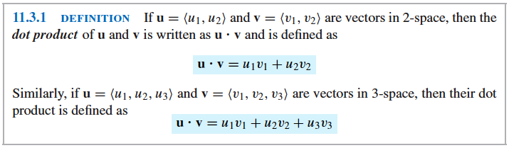
Definition 11.3.1 (p. 785)
DOT (SCALAR) PRODUCT

Slide 28
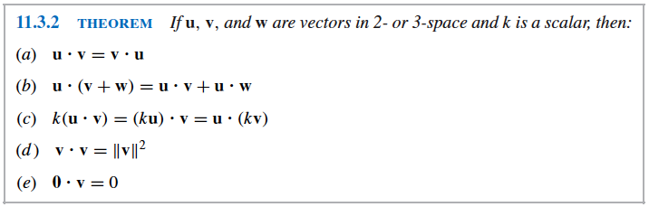
Theorem 11.3.2 (p. 785)
ALGEBRAIC PROPERTIES

Slide 29
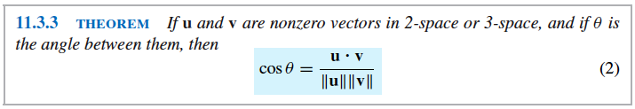
Application of Dot Product:
1. Angle Between Two Vectors
u
u
u
θ
θ
θ
v
v
v
Note: If u.v > 0, θ is an acute angle.
If u.v < 0 , θ is an obtuse angle.
If u.v = 0, θ is a right angle and u is perpendicular to v.

Slide 30
Application of Dot Product 2. Direction Angles
In an xy-coordinate system, the direction of a nonzero vector v is determined by the angles α and β between v and the unit vectors i and j, and in an xyz-coordinate system, the direction is determined by the angles α, β, and γ between v and the unit vectors i, j, and k. In both 2- space and 3-space, the angles between a nonzero vector v and the vectors i , j, and k are called the direction angles of v, and the cosines of those angles are called the direction cosines of v.

Slide 31
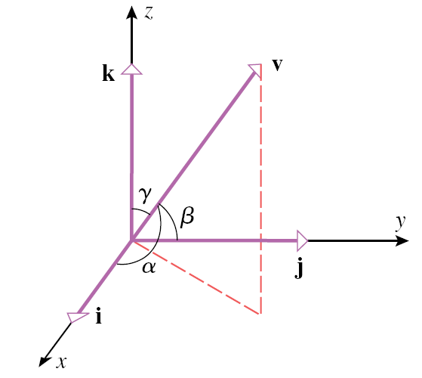
Figure 11.3.5 (p. 787)

Slide 32

The Dot (Scalar) Product

Slide 33
Exercise Set 11.3
1. Find the dot product of the vectors and the cosine of the angle between them.
b) u = <-7, 3>, v = <0, 1>
c) u = 1- 3j + 7k, v = 8i – 2j – 2k
2. a) Find u.v if ǁuǁ = 1, ǁvǁ = 2, the angle between u and v is π/6.
3. Determine whether u and v make an acute angle, an obtuse angle, or are orthogonal.
b) u = 6i +j + 3k, v = 4i – 6k
7. b) Use vectors to find the interior angles of the triangle with vertices (-1, 0), (2, -1), and (1, 4).
Example 4. pp. 788 Find the angle between a diagonal of a cube and one of its edges. Ans: 54.7°

Slide 34
Exercise Set 11.3
13. Find r so that the vector from the point
A (1, -1, 3) to the point B (3, 0, 5) is orthogonal to the vector from A to the point P (r, r, r).
16. Find the direction cosines and direction angles of a) v = 3i – 2j – 6. b) v = 3i – 4k.
Ex 4 p.656 Find the value of α for which (3i – αj + k) ┴ (i + 2j).
Ans: 3/2 From Calculus by Salas,et al. 10th ed

Slide 35
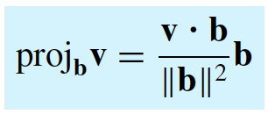
v – proj v
Orthogonal Projections
1. The orthogonal projection v on an arbitrary nonzero vector b can be obtained by normalizing b.
2. Vector component of v orthogonal to b

Slide 36
Exercise 11. 3
24. Find the vector component of v along b and the vector component of v orthogonal to b.
a. v = 2i – j + 3k, b = i +2j +2k

Slide 37
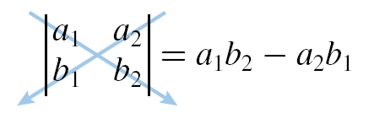
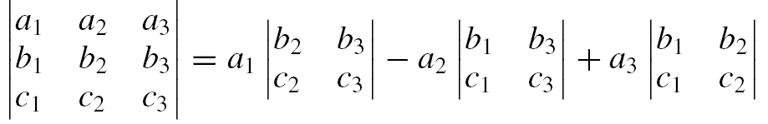
Cross (Vector) Product
Recall: Determinants for a 2 x 2 matrix
Recall: Determinants for a 3 x 3 matrix

Slide 38
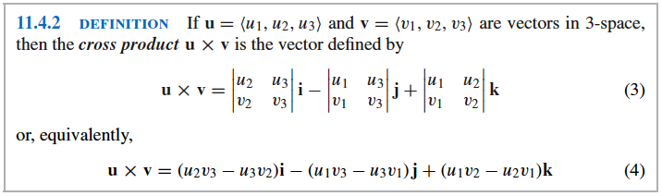
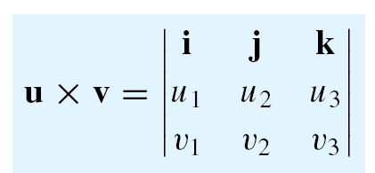
Cross (Vector) Product

Slide 39
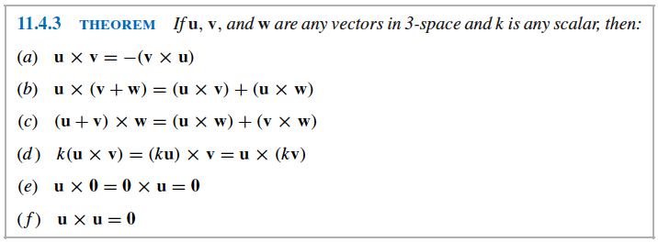
ALGEBRAIC PROPERTIES OF CROSS (VECTOR) PRODUCT

Slide 40
Geometric Properties of the Cross Product
Theorem: If u and v are vectors in 3-space, then:
a) u. (u x v) = 0 (u x v is orthogonal to u)
b) v. (u x v) = 0 (u x v is orthogonal to v)
u x v
u
v

Slide 41
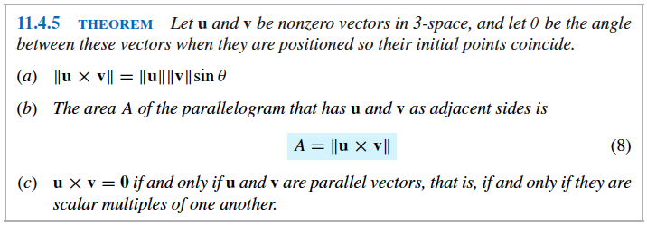
(d) The area A of the triangle is half the area of the parallelogram determined by the vectors u = AB and v = AC. (e) Distance between a point and a line L through points A and B
Application of Cross (Vector) Product

Slide 42
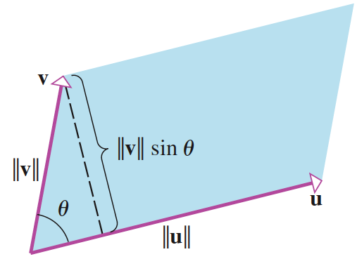
Figure 11.4.3 (p. 799)

Slide 43
Cross Product of vectors i, j k
k
j
k
i x j = k, j x k = i, k x i = j

Slide 44
Exercise 11.4
4. Find u x v and check that it is orthogonal to both
u = 3i +2j - k and v = - 1i – 3j + k.
7. Let u = <2, -1, 3>, v =<0, 1, 7> and
w = <1, 4, 5>. Find
a) u x ( v x w) b) (u x v) x (v x w)
10. Find two unit vectors that are orthogonal to both u = -7i + 3j + k and v = 2i + 4k.

Slide 45
Exercise 11. 4
18. Find the area of the parallelogram that has
u = 2i + 3j and v = -i + 2j – 2k as adjacent sides.
20. Find the area of the triangle with vertices P(2, 0, -3), Q(1, 4, 5), R(7, 2, 9).

Slide 46

The Scalar Triple Products
Definition:
If $u= <u_{1}$, $u_{2}$, $u_{3}$>, $v= <v_{1}$, $v_{2}$, $v_{3}$>, and $w= <w_{1}$, $w_{2}$, $w_{3}$> are vectors in 3-space, then the number
$$u . (v x w )$$
is called the scalar triple product of $u, v and w$.
$$u . \left(v x w \right)= \begin{matrix}u_{1} & u_{2} & u_{3} \\ v_{1} & v_{2} & v_{3} \\ w_{1} & w_{2} & w_{3}\end{matrix}$$

Slide 47
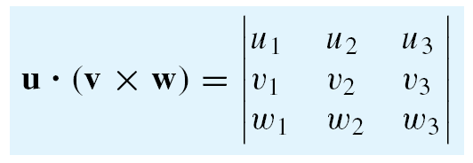
Scalar Triple Product
Algebraic Properties:
u.(v x w) = w.(u x v) = v. (w x u)
u.(v x w) = (u x v).w or u.v x w = u x v.w

Slide 48
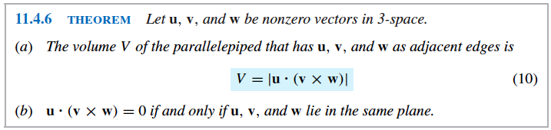
Geometric Properties and Application of Scalar Triple Product
(c) The volume V of the tetrahedron (or pyramid) that has u, v, and w as adjacent edges is V= 1/6 | u. (v x w) |.

Slide 49
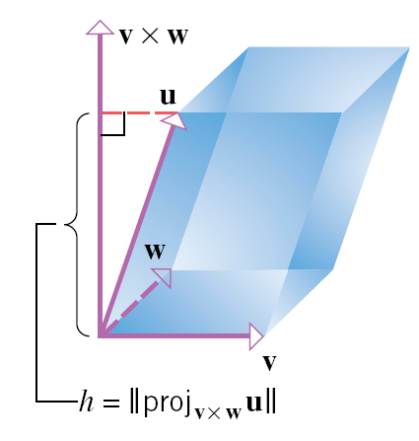
Figure 11.4.6 (p. 801)

Slide 50
Exercise Set 11.4
24. Find u . (v x w) where u = i, v = i + j,
w = i + j + k.
26. Find the volume of the parallelepiped that has u = 3i + j + 2k, v = 4i + 5j + k and,
w = i + 2j + 4k as adjacent sides.

Slide 51

Exercise Set 11.4
27b. Determine whether the vectors u = 5i – 2j + k,
v = 4i – j + k, and w = i - j lie in the same plane.
30. Show that in 3-space, the distance d from a point P to the line L through points A and B can be expressed as
$$d= \frac{ǁAP x ABǁ}{ǁABǁ}$$
31. Find the distance between the point P (-3, 1, 2) and the line L through the points A(1, 1, 0) and
B(-2, 3, -4).
33. Find the volume of the tetrahedron with vertices P(-1, 2, 0), Q(2, 1, -3) R(1, 0, 1), S (3, -2, 3).

Slide 52

Line in Space
Parametric Equations of a Line
- provide the most convenient form for representing lines algebraically.
1. Line determined by a Point and a Vector
Consider a line L in 3-space that passes through the point $P_{0} (x_{0},y_{0}, z_{0}$) and is parallel to the nonzero vector
v = <a, b, c>. Then L consists of points P (x, y, z) for which the vector P₀ P is parallel to v. in other words, the point P (x, y, z) is on L if and only if $P_{0}P$ is a scalar multiple of v, say
$P_{0}P$ = t v
or $<{x −x}_{0}, y − y_{0},z −z_{0}> = <ta, tb, tc>$
which implies that
$x − x_{0}$ = at , y – $y_{0}$ = bt, z – $z_{o}$ = ct
Thus, $x= x_{0}+at, y= y_{0}+bt, z=z_{0}+ct$

Slide 53
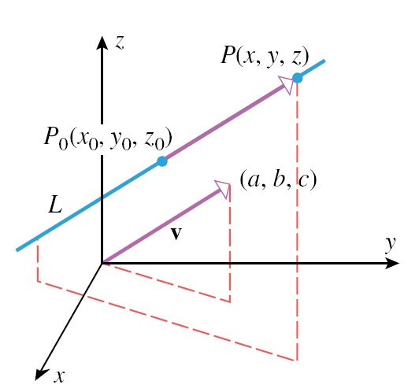
Figure 11.5.2 (p. 806)

Slide 54
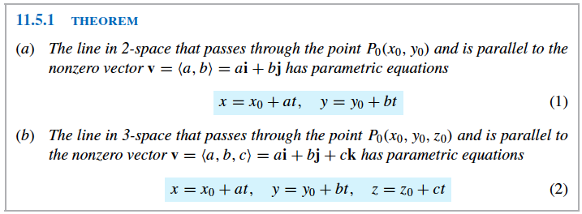
Theorem 11.5.1 (p. 806)

Slide 55

Line in Space
Parametric Equations of a Line Segment
obtained by finding parametric equations for the entire line, and then restricting the parameter so that only the desired segment is generated.
Vector Equation of a Line
- vector notation can express the parametric equations of a line more compactly.
$$<x,y> = <x_{0}+at, y_{0}+bt>$$
$$<x,y, z> = <x_{0}+at, y_{0}+bt, z_{0}+ct>$$
or, equivalently,
$<x,y> = <x_{0,} y_{0}> + t<a, b>$→ (1)
$<x,y> = <x_{0,} y_{0,}z_{0}> + t<a, b, c>$→ (2)

Slide 56

Line in Space
In 2-space :
$r=<x, y>, r_{0}= <x_{0}, y_{0}>, v= <a, b>$→ (3)
In 3-space:
$r=<x, y, z>, r_{0}= <x_{0}, y_{0, }z_{0}>, v= <a, b, c>$→ (4)
Substituting (3) and (4) in (1) and (2), respectively, yields
r = r₀ + tv
Note: Two lines in 3-space that are not parallel and do not intersect are called skew lines. Any two skew lines lie in parallel planes.

Slide 57
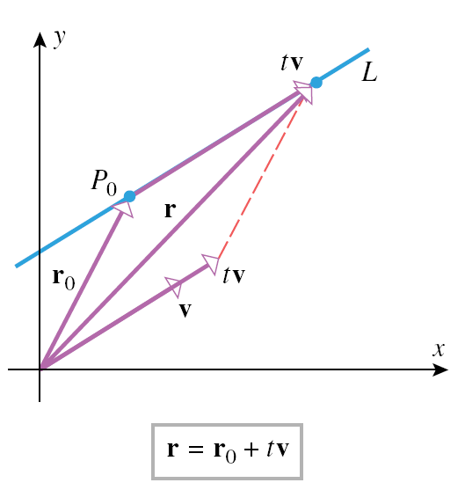
Figure 11.5.4 (p. 809)

Slide 58

Exercise Set 11.5
4b. Find parametric equations for the line through $P_{1} \left(−1, 3, 5\right)and P_{2} \left(−1, 3, 2\right).$
6b. Find parametric equations for the line whose vector equation is <x, y, z> = <-1, 0, 2> +
t <-1, 3, 0>.
8b. Find a point P on the line and a vector v parallel to the line xi + yj + zk = (1i + j – 2k) + tj.
10a. Express the given parametric equations of a line x = t, y = -2 + t using bracket notation and i, j k notation.

Slide 59

Exercise Set 11.5
Find parametric equations of the line that satisfies the stated conditions.
16. The line through (0, 3) that is parallel to the line x = -5 + t, y = 1 – 2t.
18. The line is tangent to the parabola y = $x^{2}$ at the point (-2, 4).
20. The line through (2, -1, 5) that is parallel to
<-1, 2, 7>.
22. The line through the origin that is parallel to the line given by x = t, y = -1 + t, z = 2.

Slide 60

Exercise Set 11.5
24. Where does the line <x, y> = <4t, 3t> intersect the circle $x^{2}+ y^{2}=25?$
26. Find the intersections of the line x = -1 + t,
y = 3 + t, z = 4 – t with the xy-plane, the xz-plane, and the yz-plane.
52. Let L be the line that passes through the point $P_{0} (x_{0}, y_{0}, z_{0} )$and is parallel to the vector v = <a, b, c>, where a, b, and c are nonzero. Show that a point P (x, y, z) lies on the line L if and only if
$\frac{x − x_{0} }{a}$ = $\frac{y − y_{0}}{b}= \frac{z − z_{0}}{c}$
These equations, which are called the symmetric equations of L, provide a nonparametric representation of L.

Slide 61
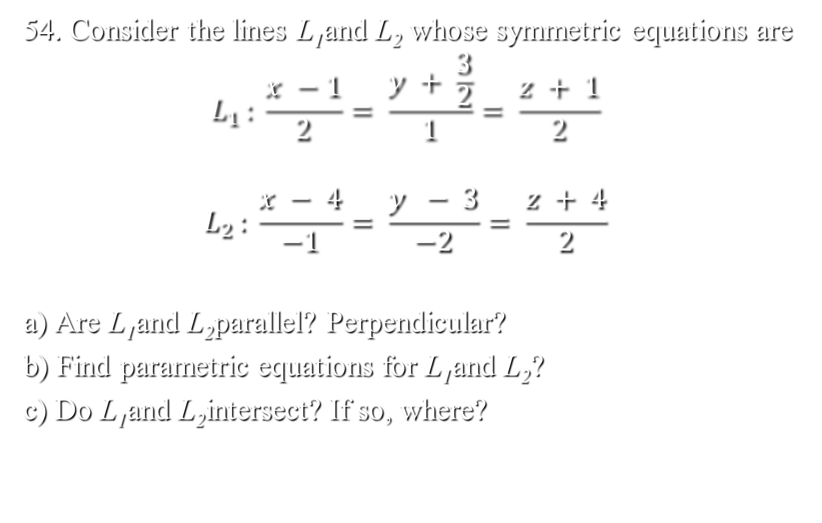
Exercise Set 11.5
54. Consider the lines L₁and L₂ whose symmetric equations are
$$L_{1 }: \frac{x −1}{2}= \frac{y + \frac{3}{2}}{1}= \frac{z + 1}{2}$$
$$L_{2 }: \frac{x − 4}{−1}= \frac{y − 3}{−2}= \frac{z + 4}{2}$$
a) Are L₁and L₂parallel? Perpendicular?
b) Find parametric equations for L₁and L₂?
c) Do L₁and L₂intersect? If so, where?

Slide 62
Exercise Set 11.5
30. Show that the lines L₁ : x + 1 = 4t, y – 3 = 4t, z – 1 = 0 and L₂ : x + 13 = 12t, y – 1 = 6t, z – 2 = 3t intersect, and find their point of intersection.
32. Show that the lines L ₁: x = 2 + 8t, y = 6 – 8t, z = 10t and L₂ : x = 3 + 8t, y = 5 – 3t, z = 6 + t are skew lines.
34. Determine whether the lines L ₁: x = 5 + 3t, y = 4 – 2t,
z = -2 + 3t and L₂ : x = -1 + 9t, y = 5 – 6t, z = 3 + 8t are parallel.
38. Show that the lines L₁ : x = 1 + 3t, y = -2 + t, z = 2t and L₂ : x = 4 – 6t, y = -1 – 2t, z = 2 - 4t are the same.
36. Determine whether the points P₁ (1, 0, 1), P₂ (3, -4, -3), and P₃ (4, -6, -5) lie on the same line.
44. Describe the line segment represented by the vector equation <x, y, z> = <-2, 1, 4> + t <3, 0, -1> (0 ≤ t ≤ 3)

Slide 63
Plane in Space
A. Plane Parallel to the Coordinate Planes
1. x = a : plane through (a, 0, 0) that is parallel to the
yz-plane.
2. y = b : plane through (0, b, 0) that is parallel to the
xz-plane.
3. z = c : plane through (0, 0, c) that is parallel to the
xy-plane.
B. Determination of Plane
a) by a Point and a Normal Vector
A vector perpendicular to a plane is called a normal to the plane.
Consider a plane passing through P₀ (x₀ , y₀, z₀ ) and perpendicular to the vector n = <a, b, c>.

Slide 64
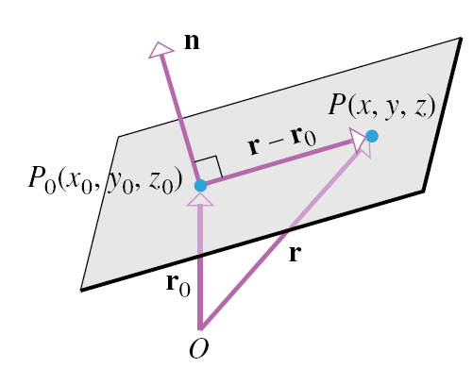
Figure 11.6.3 (p. 813)

Slide 65
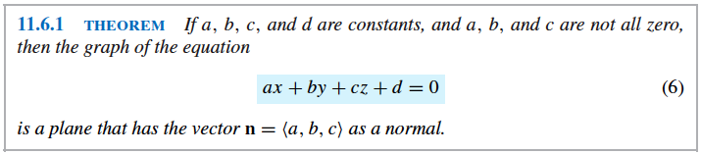
Theorem 11.6.1 (p. 814)

Slide 66

Plane in Space
$$r_{0}= <x_{0}, y_{0}, z_{0}>and r= <x, y, z>$$
${r − r}_{0 }is orthogonal to n$or $n . \left(r − r_{0}\right)=0$
so <a, b, c> . $<x − x_{0}, y − y_{0, } z − z_{0}> =0 →$ 1
Thus,
$$a \left(x − x_{0}\right)+b \left(y −y_{0}\right)+c \left(z − z_{0}\right)=0→2$$
ax + by + cz + d = 0 → 3
(1) vector form of the equation of the plane
(2) point-normal form of the equation of the plane
(3) general form of the equation of the plane

Slide 67
Theorem 11.6.1 (p. 814)

Slide 68
Plane in Space
b) by a Parallel Plane
Geometrically, two planes are parallel if and only if their normals are parallel vectors. Mathematically, one normal is a scalar multiple of the other normal.

Slide 69

Plane in Space
c) By a point in the plane and two nonparallel vectors that are parallel to the plane
d) Three noncollinear points that lie in the plane
C. Intersecting Planes
Two positive angles of intersection – an acute angle and a supplement of that angle.
The acute angle, θ, between the planes:
$$\cos{θ= \frac{│n_{1} . n_{2}│}{ǁn_{1}ǁ ǁn_{2}ǁ}}$$

Slide 70
Plane in Space
Distance Problems Involving Planes
a) Point and a Plane
b) Two Parallel Planes
c) Two Skew Lines
The three problems are related. If the distance between a point and a plane is determined, the distance between parallel planes can be determined by computing the distance between one of the planes and an arbitrary point in the other plane. Moreover, the distance between two skew lines can be determined by computing the distance between parallel planes containing them.

Slide 71

Plane in Space
Theorem:
1. The distance D between a point P (x , y, z) and the plane
ax + by + cz + d = 0 is
D = $\frac{│ax_{0}+by_{0}+cz_{0}+d │}{\sqrt{a^{2} + b^{2} + c^{2}}}$
2. The distance D between parallel planes
ax + by +cz + $d_{1}=0$and ax + by + cz + $d_{2}=0$is
D = $\frac{│d_{1} − d_{2}│}{\sqrt{a^{2}+ b^{2}+ c^{2}}}$

Slide 72
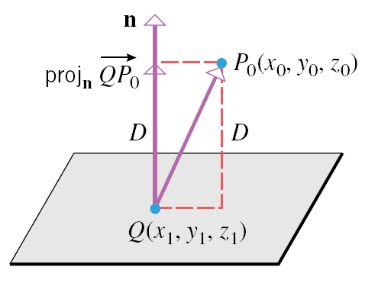
Figure 11.6.9 (p. 817)

Slide 73
Exercise Set 11.6
4. Find an equation of the plane that passes through the point P (-1, -1, 2) has the vector n = <-1, 7, 6> as a normal.
12. Find an equation of the plane that passes through the points (3, 2, 1), (2, 1, -1), and (-1, 3, 2).
20. Find the acute angle of intersection of the planes
x +2y – 2z = 5 and 6x – 3y + 2z = 8.
42. Find parametric equations of the line of intersection of the planes 3x – 5y + 2z = 0 and z = 0.
44. Find the distance between the point P (0, 1, 5) and the plane 3x + 6y – 2z – 5 = 0.
46. Find the distance between the parallel planes
x + y + z = 1 and x + y + z = -1.
48. Find the distance between the skew lines L₁ : x = 3 – t,
y = 4 + 4t, z = 1 + 2t and L₂ : x = t, y = 3, z = 2t.

Slide 74
Exercise Set 11.6
14. Determine whether the planes a) 3x -2y + z = 4 and 6x – 4y + 3z = 7. b) y = 4x – 2z + 3 and
x = ¼ y + ½ z. c) x + 4y + 7z = 3 and 5x – 3y + z = 0 are parallel, perpendicular, or neither.
16. Determine whether the line and plane a) x = 3 – t , y = 2 + t, z = 1 – 3t and 2x + 2y – 5 = 0. b) x = 1 – 2t,
y = t, z = -t and 6x – 3y + 3z = 1. c) x = t, y = 1 – t,
z = 2 + t and x + y + z = 1. are parallel, perpendicular, or neither.
18. Determine whether the line and plane a) x = 3t,
y = 5t, z = -t and 2x – y + z + 1 = 0. b) x = 1 + t,
y = -1 + 3t, z = 2 + 4t and x – y + 4z = 7 intersect.

Slide 75
Exercise Set 11.6
Find an equation of the plane that satisfies the stated conditions.
26. The plane that contains the line x = -2 + 3t, y = 4 + 2t,
z = 3 – t and is perpendicular to the plane x – 2y + z = 5.
28. The plane through (-1, 4, -3) that is perpendicular to the line x – 2 = t, , y + 3 = 2t, z = -t.
30. The plane through the points P ₁(-2, 1, 4) and P₂ (1, 0, 3) that is perpendicular to the plane 4x – y + 3z = 2.
32. The plane that contains the point (2, 0, 3) and the line x = -1 + t, y = t, z = -4 + 2t.
34. The plane that contains the line x = 3t, y = 1 + t, z = 2t and is parallel to the intersection of the planes y + z = - 1 and 2x – y + z = 0.

Slide 76
Vector-Valued Functions
- Functions whose values are vectors. Such functions provide a unified way of studying parametric curves in 2-space or 3-space and are a basic tool for analyzing the motion of particles along curved paths.
The calculus of vector-valued functions - differentiation and integration – will define three fundamental vectors that can be used to describe such basic characteristics of curves as curvature and twisting tendencies.

Slide 77

Vector-Valued Functions
Form:
2-space : $r=r\left(t\right)= <x\left(t\right), y\left(t\right)> =x\left(t\right)i+y \left(t\right)j$
3-space : $r=r\left(t\right)= <x\left(t\right), y\left(t\right), z\left(t\right)> =x\left(t\right)i+y\left(t\right)j+z\left(t\right)k$
I. Derivatives
The derivative of a vector-valued function is defined by a limit similar to that for the derivative of a real-valued function.
1. Definition:
If r(t) is a vector-valued function, the derivative of r with respect to t is the vector-valued function r’ given by
$$r^{′}\left(t\right)=\lim_{h→0}{\frac{r\left(t+h\right)−r(t)}{h}}$$
The domain of r’ consists of all values of t in the domain of r(t) for which the limit exists.
2. Standard notations: $\frac{d}{dt} \left[r\left(t\right)\right], \frac{dr}{dt}, r^{′}\left(t\right), r′$

Slide 78
Vector-Valued Functions
3. Derivative Rules
Many of the rules for differentiating real-valued functions have analogs in the context of differentiating vector-valued functions.
Theorem (Rules of Differentiation)
Let r(t), r₁ (t), and r₂ (t) be differentiable vector-valued functions that are all in 2-space or all in 3-space, and let f(t) be a differentiable real-valued function, k a scalar, and c a constant vector. Then the following rules of differentiation hold:

Slide 79

Vector-Valued Function
$$a) \frac{d}{dt} \left[c\right]=0$$
$$b) \frac{d}{dt} \left[k r\left(t\right)\right]=k \frac{d}{dt}\left[r\left(t\right)\right]$$
$$c) \frac{d}{dt} [ r_{1}\left(t\right)+ r_{2}\left(t\right)= \frac{d}{dt} \left[ r_{1} \left(t\right)\right]+ \frac{d}{dt} [ r_{2}\left(t\right)]$$
$$d) \frac{d}{dt} \left[r_{1}\left(t\right) − r_{2} \left(t\right)\right]= \frac{d}{dt} \left[r_{1} \left(t\right)\right]− \frac{d}{dt} \left[r_{2}\left(t\right)\right]$$
$$e) \frac{d}{dt}\left[f\left(t\right)r\left(t\right)\right]=f\left(t\right) \frac{d}{dt}\left[r\left(t\right)\right]+ \frac{d}{dt}[f\left(t\right)]r(t)$$

Slide 80

Vector-Valued Functions
$$\frac{d}{dt} {[r}_{1}\left(t\right). r_{2} (t)]= r_{1} (t) . \frac{{dr}_{2}}{dt} + \frac{{dr}_{1}}{dt} . r_{2}(t)$$
$$\frac{d}{dt} {[r}_{1}\left(t\right) x r_{2} (t)]= r_{1} (t) x \frac{{dr}_{2}}{dt} + \frac{{dr}_{1}}{dt} x r_{2}(t)$$
II.Antiderivatives
An antiderivative for a vector-valued function r(t) is a vector-valued function R(t) such that
$$R^{′}\left(t\right)=r\left(t\right)$$
Using integral notation,
$$\int{r\left(t\right) dt= R\left(t\right)+C}$$
where C represents an arbitrary constant vector.

Slide 81

Vector- Valued Function
Definite Integrals
If r(t) is a vector-valued function that is continuous on the interval a ≤ t ≤ b, then the definite integral of r(t) over this interval is the limit of Riemann sums, that is,
$$\int_{a}^{b}{r\left(t\right)dt=\lim_{\max{∆t_{k}→0}}{}\sum_{ k=1}^{n}{r \left(t_{k}\right)∆t_{k}}}$$
2-space : $\int_{a}^{b}{r\left(t\right)dt}=(\int_{a}^{b}{x\left(t\right)dt) i+(\int_{a}^{b}{y\left(t\right)dt ) j}}$
3-space : $\int_{a}^{b}{r\left(t\right)dt=(\int_{a}^{b}{\left(x\right)t dt) i+(\int_{a}^{b}{y\left(t\right)dt ) j+(\int_{a}^{b}{z\left(t\right)dt ) k}}}}$

Slide 82

Vector-Valued Functions
Rules of Integration
As with differentiation, many of the rules for integrating real-valued functions have analogs for vector-valued functions.
Theorem: Let r(t), r (t), and r(t) be vector-valued functions in 2-space or 3-space that are continuous on the interval a ≤ t ≤ b, and let k be a scalar. Then the following rules of integration hold:
$$a) \int_{a}^{b}{k r\left(t\right)dt=k}\int_{a}^{b}{r\left(t\right)dt}$$
$$b) \int_{a}^{b}{{[r}_{1}\left(t\right)+ r_{2}\left(t\right)] dt= \int_{a}^{b}{r_{1}\left(t\right)dt+ \int_{a}^{b}{r_{2}\left(t\right)dt}}}$$

Slide 83

Vector-Valued Functions
c) $\int_{a}^{b}{{[r}_{1}\left(t\right)− r_{2}\left(t\right)] dt= \int_{a}^{b}{r_{1}\left(t\right)dt− \int_{a}^{b}{r_{2}\left(t\right)dt}}}$

Slide 84

Exercise Set 12.2
10. Find r’(t) where r(t) = (tan ⁻¹ t ) i + t cos t j - √t k.
30. Calculate $\frac{d}{dt} \left[r_{1}\left(t\right). r_{2}\left(t\right)\right] and \frac{d}{dt} [r_{1}\left(t\right) x r_{2}\left(t\right)]$
where $r_{1}\left(t\right)=\cos{t i+\sin{t j+t k, { and r}_{2} \left(t\right)=i+t k}}$
Evaluate the indefinite integral.
32. $\int{(t^{2} i −2t j+ \frac{1}{t} k) dt}$
34. $\int{<e^{−t}, e^{t} , 3t^{2}> dt}$
Evaluate the definite integral.
36. $\int_{0}^{1}{\left(t^{2} i+ t^{3} j \right)dt}$
38. $\int_{−3}^{3}{<{(3 −t)}^{3/2}}, {\left(3+t\right)}^{3/2}$, 1 ) dt
40. $\int_{0}^{1}{(e^{2t}} i+ e^{−t}$ j + t k) dt

